Slide 1


Rovinj/Hrvatska,
13-16.10.2024.
… presentation will start soon
Simplifying AI Complexity:
Unmasking the conspiracy
Gentle introduction to Generative AI for all to understand and empower
presented by:
Aleksandar Stoisavljević, Director of Engineering

Slide 2


Slide 3
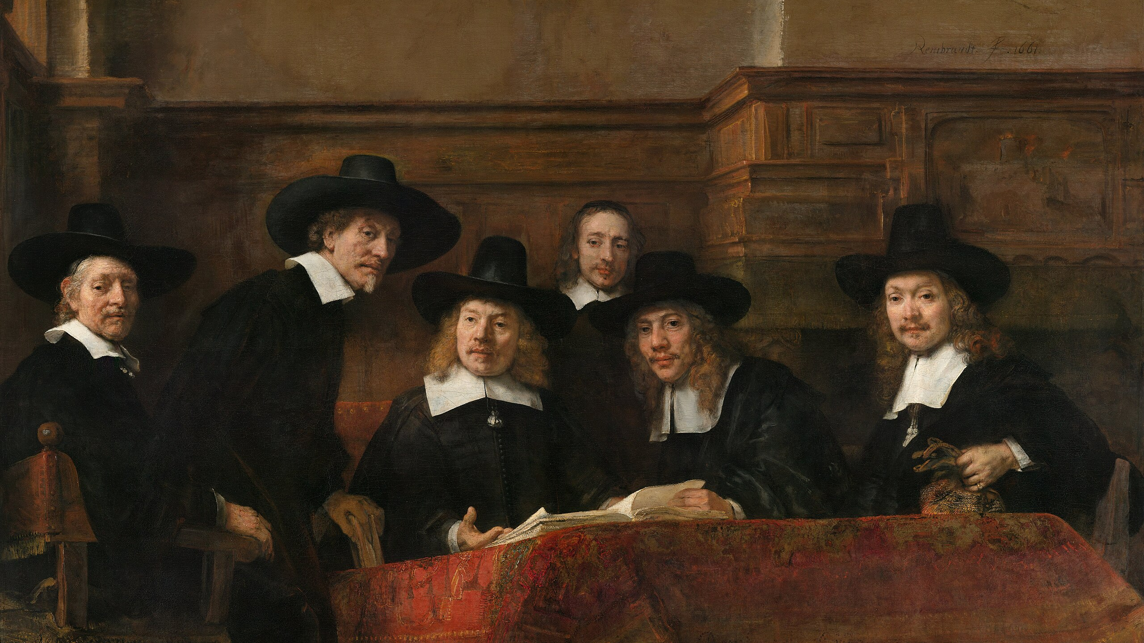

Slide 4



Aleksandar Stoisavljević
soft. architect & director of engineering @Jatheon
Accomplished individual with a strong background in Java (20+ yrs in IT business). Goal oriented, analytical and sharp individual with a lot of energy. Strong will to spread inspiration among his co-workers. Coming from city of Novi Sad, one of the biggest IT centres in Serbia, Aleksandar has been working in various environments. Professional career started as desktop developer (Delphi IDE) and joined international company in 2007. with its headquarters in Amsterdam. Primary focus were various kinds of server-side systems and web applications. As from 2015. actively learning and helping clients to prepare and adopt for the Cloud. In 2017. Joined Jatheon where he works nowadays as Software Architect & Director of Engineering (DoE).
In the “off-working hours” father of two.
Like to play table tennis.

Slide 5

Agenda
- Chapter 1 - LLMs – what it is and how it works
- Chapter 2 - Retrieval Augmented Generation (RAG)
- Chapter 3 – Langchain4j and demo(s)
*
- RAG Langchain4J demo(s)
- Q & A
* (depending on available time)

Slide 6
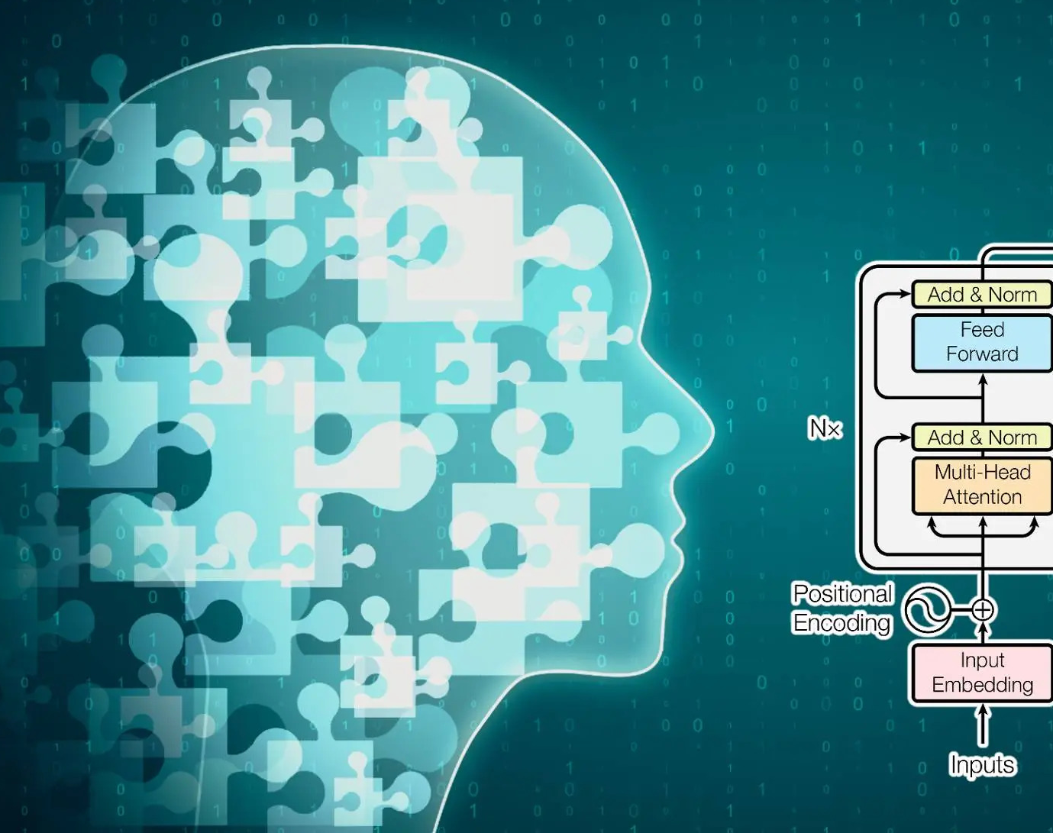
Chapter 1
How does LLM work?

Slide 7
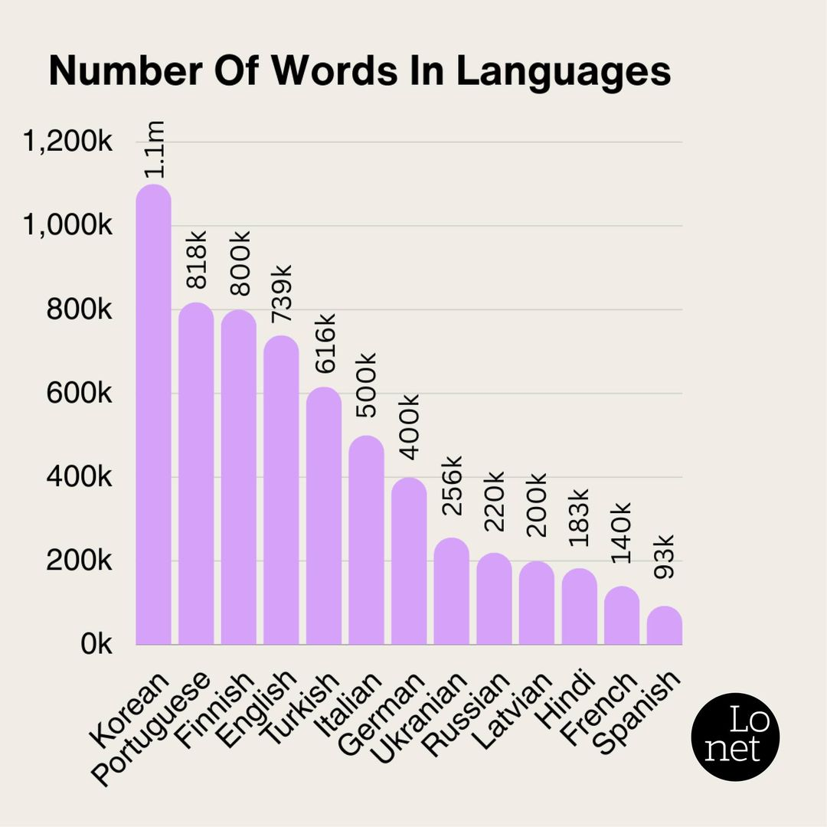
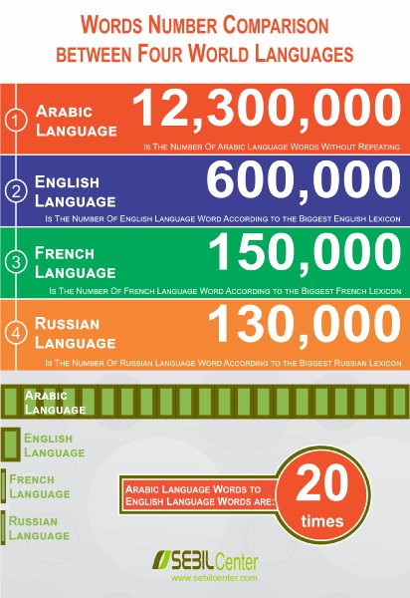

Slide 8
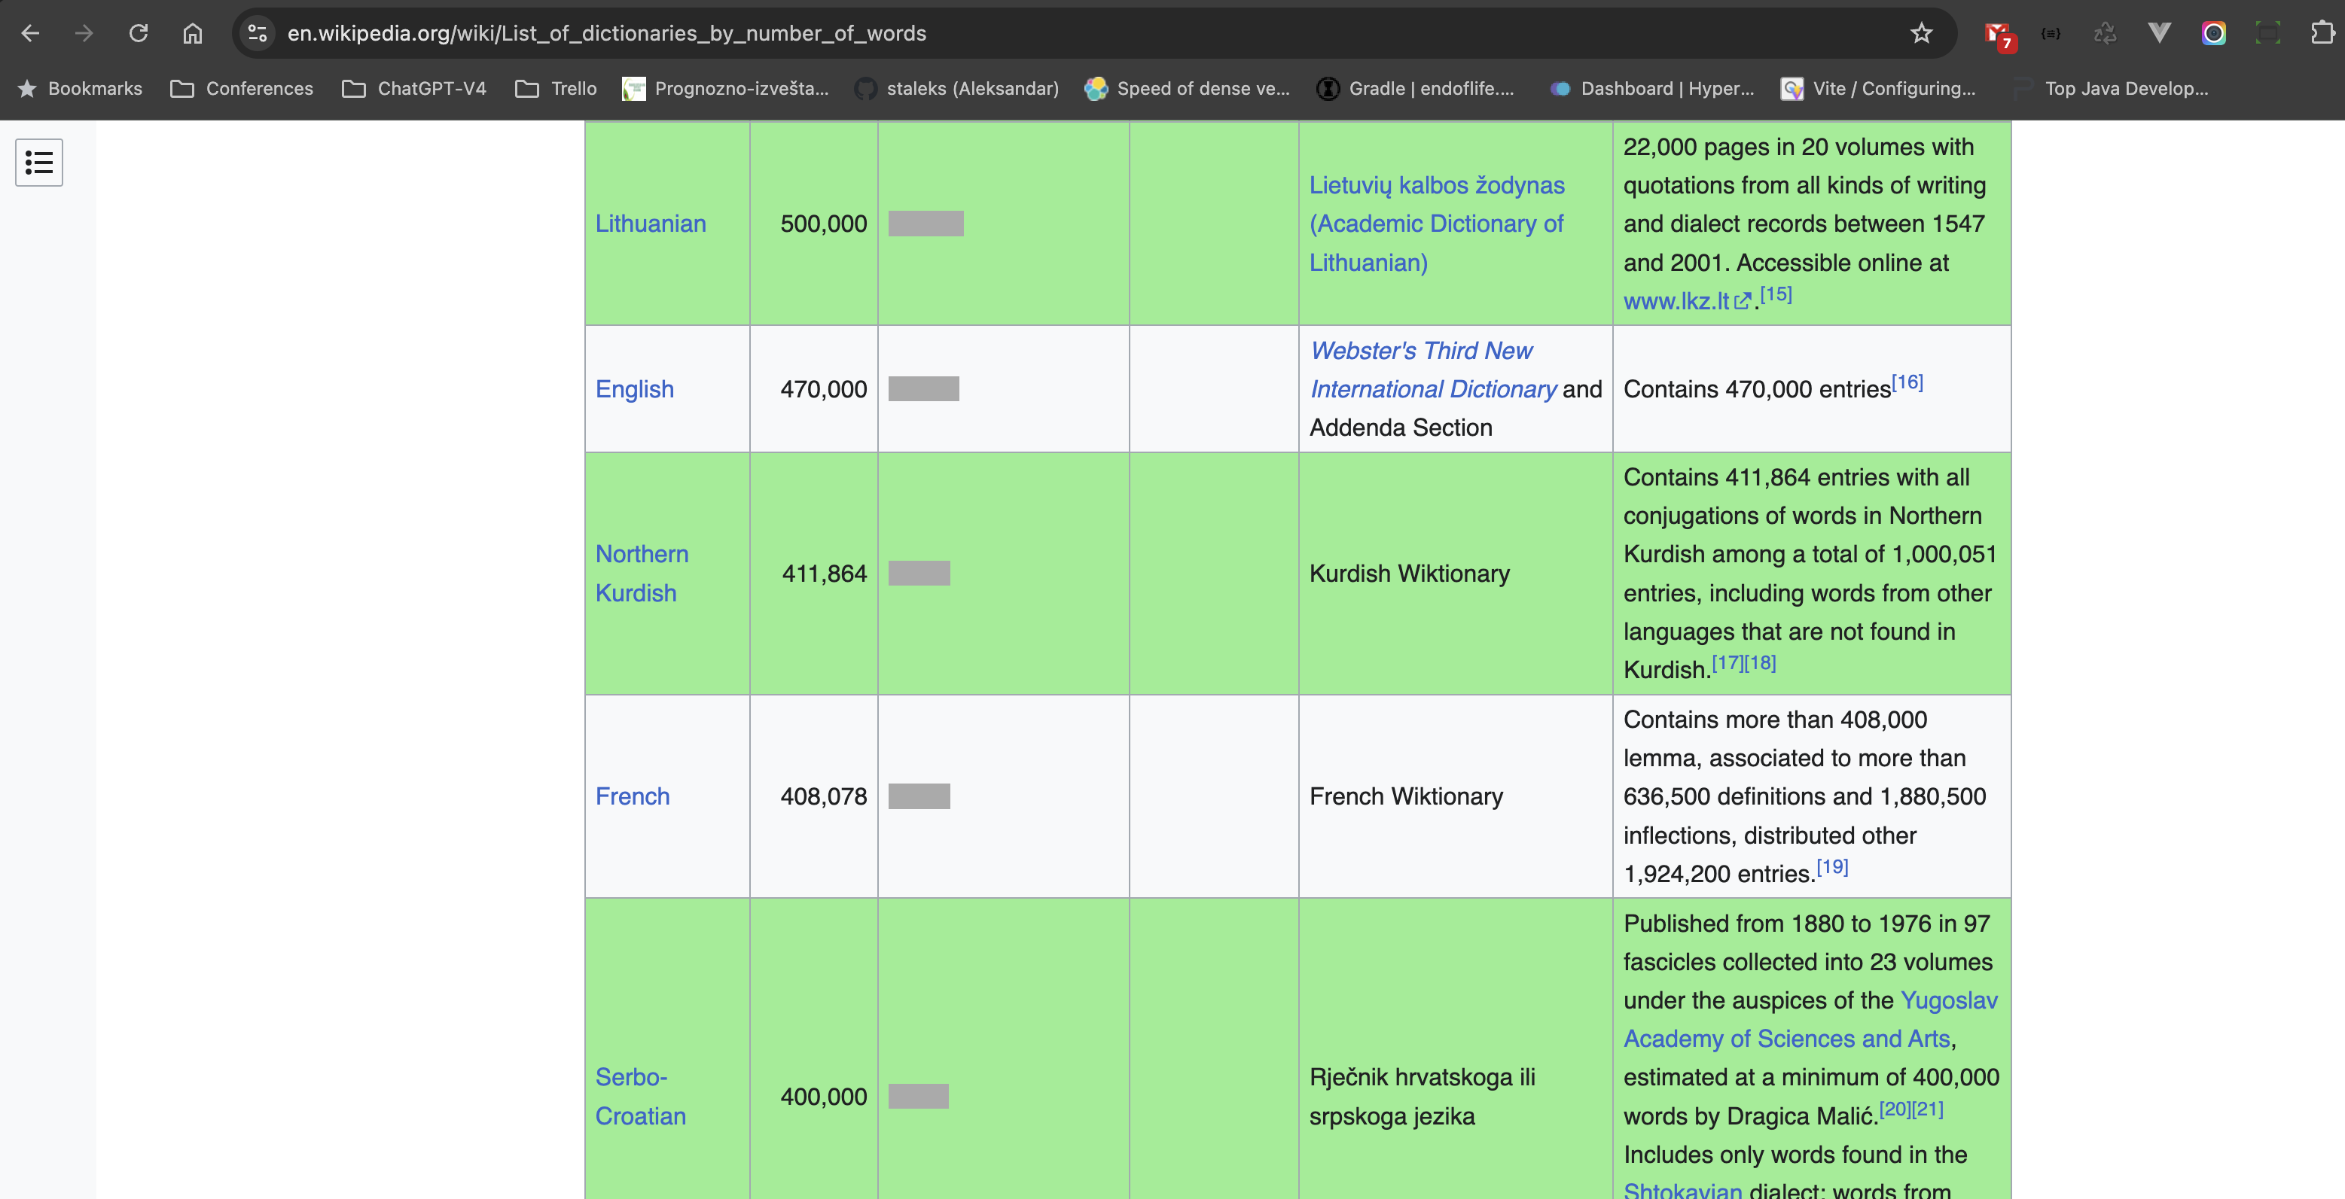

Slide 9
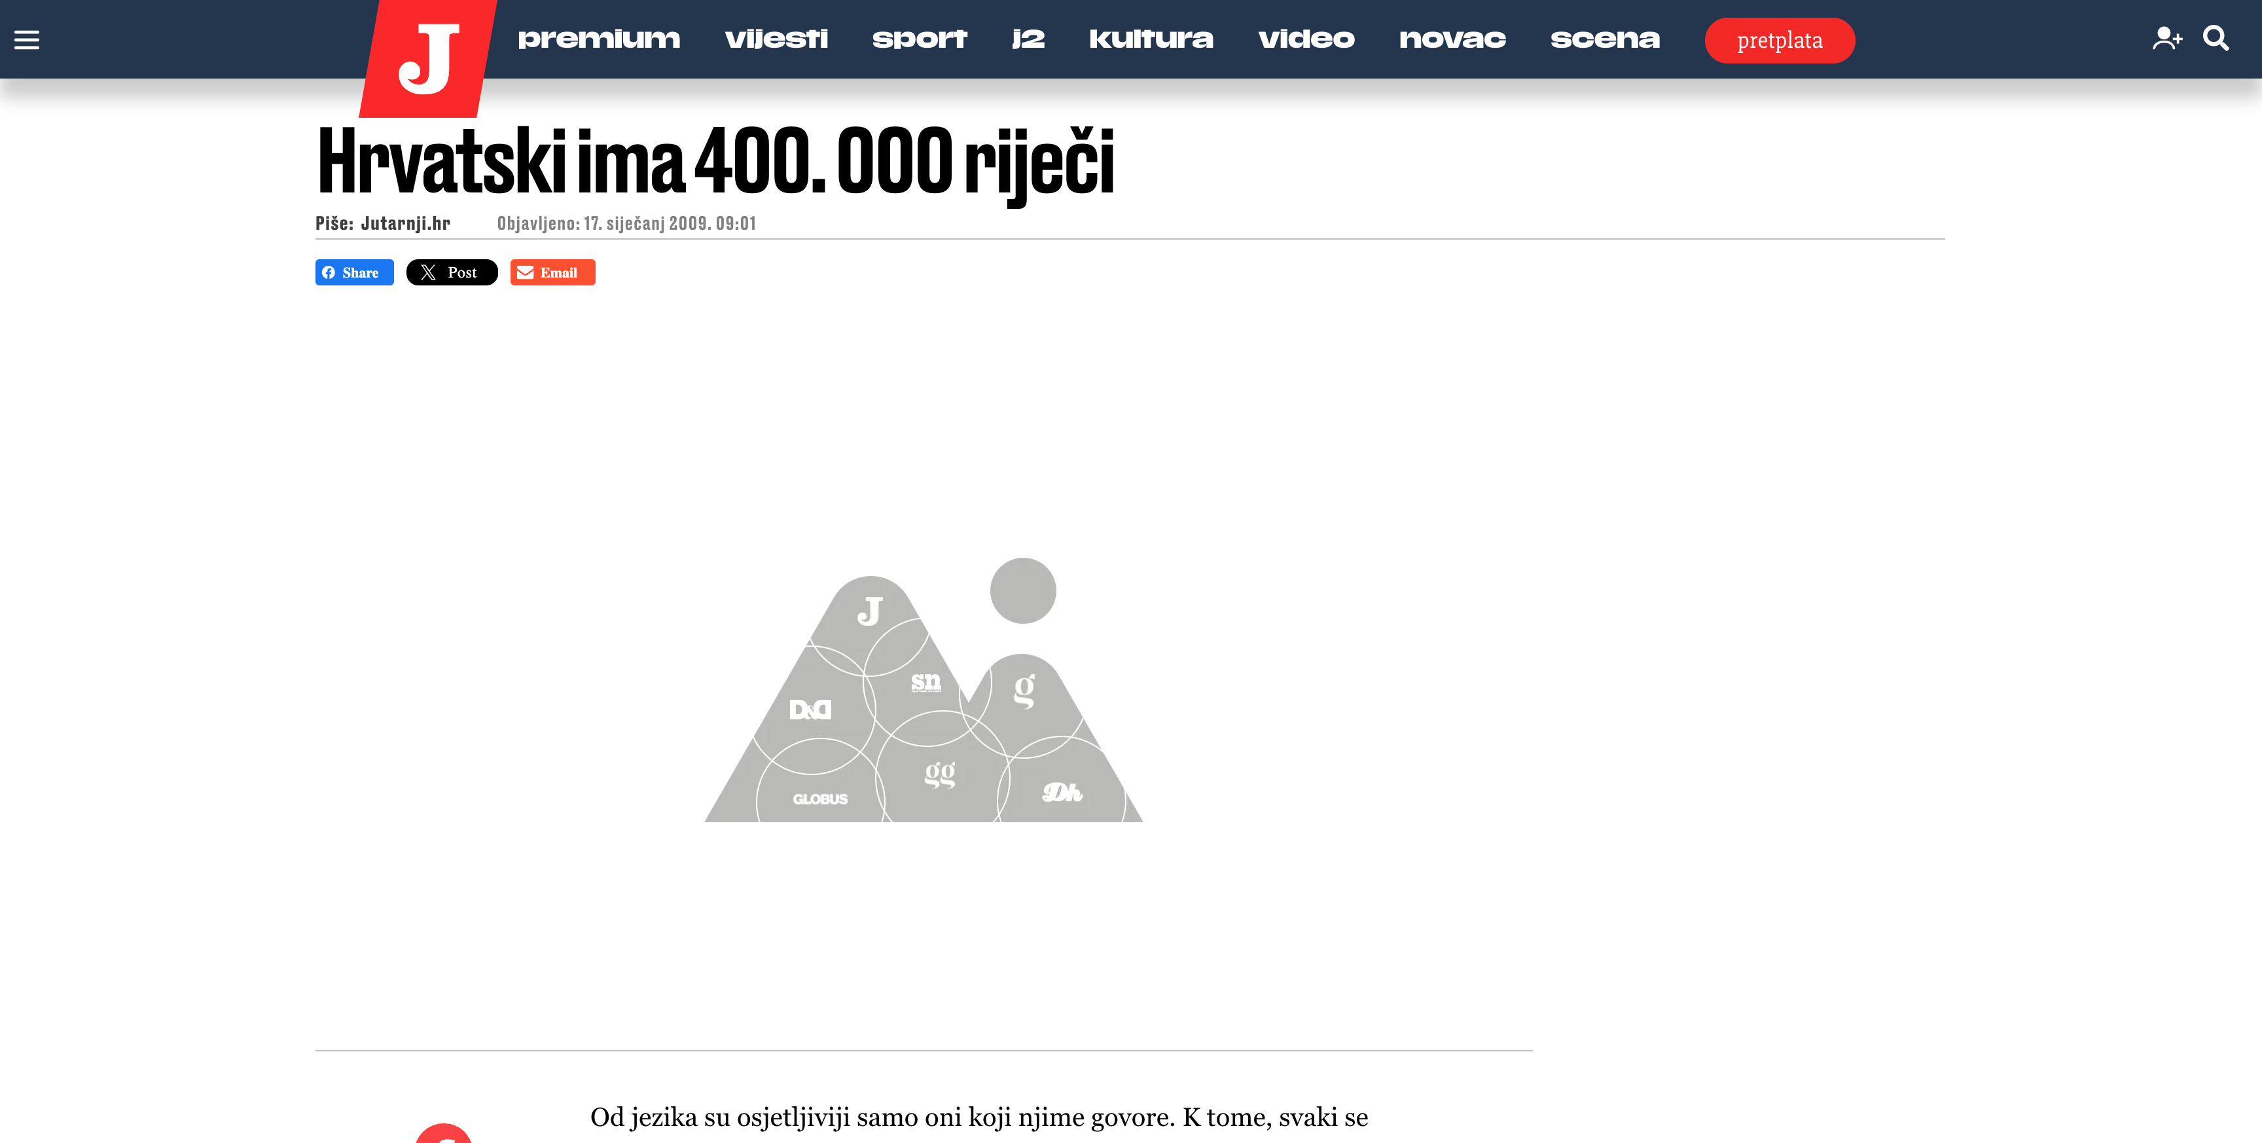

Slide 10
How does LLM work?
1. - Abrakadabra
2. - Agregat
3. - Azija
4. - Aždaja
…
399.999. - Zebra
400.000. - Zima
Hvala Vam što ste došli na prezentaciju.
5 25 100 43 7 54 72

Slide 11
How does LLM work?
hvala: ti
5%
hvala: vam
5%
hvala: mu
3%
…
hvala: zima
0,001%
Sum (100%)
2-grams

Slide 12
How does LLM work?
hvala vam: puno
10%
hvala vam: na
8%
hvala vam: što
15%
…
hvala vam: zima
0,00001%
Hvala Vam što ste došli na prezentaciju.
Sum (100%)
3-grams
5 25 100 43 7 54 72

Slide 13

The Transformer
model architecture

Slide 14
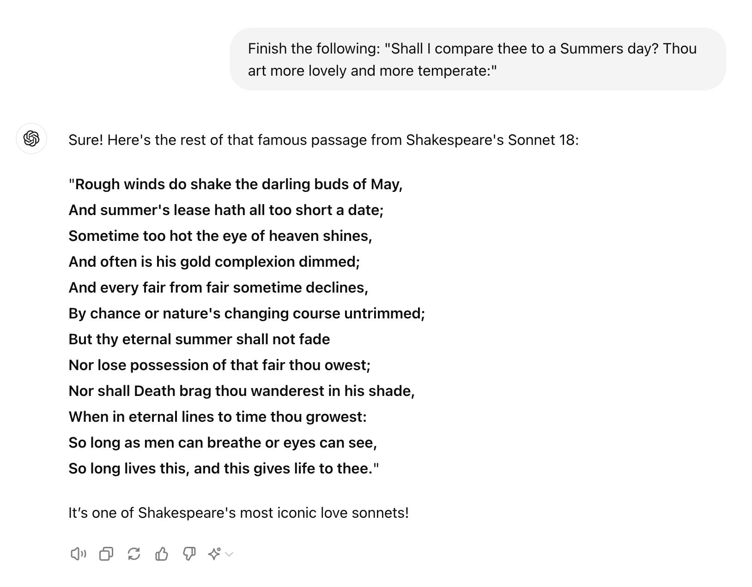
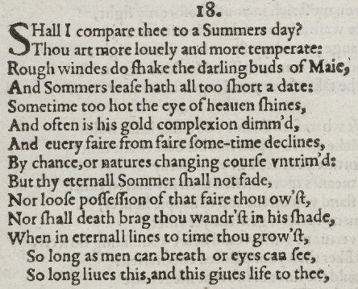
Generating text

Slide 15
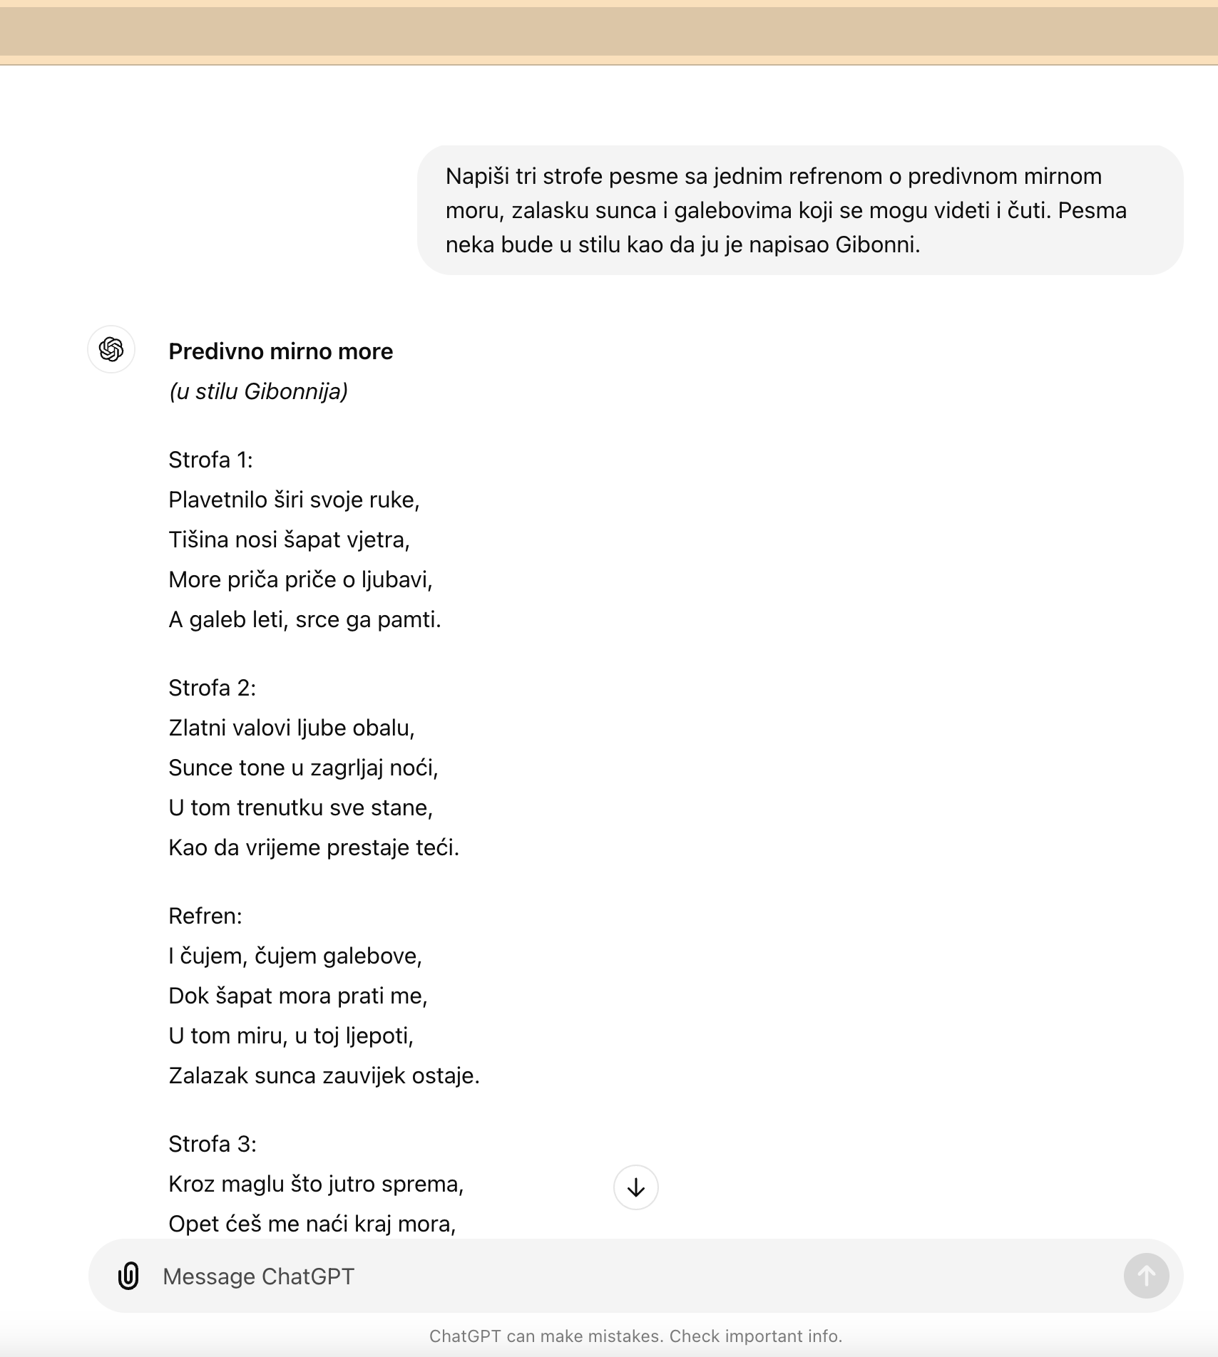
How about creativity?

Slide 16
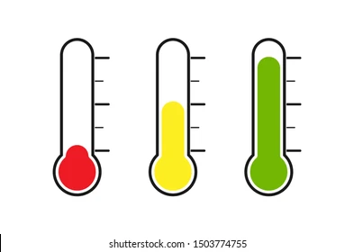
Creativity & temperature
hvala vam: što
15%
most likely
hvala vam: puno
10%
likely
hvala vam: na
8%
hvala vam: zima
0,00001%
Hvala Vam …
5 25
Notes:
This process is call “Raising the Temperature”

Slide 17

Unhinged teenager
has a lot of knowledge but needs some steering

Slide 18
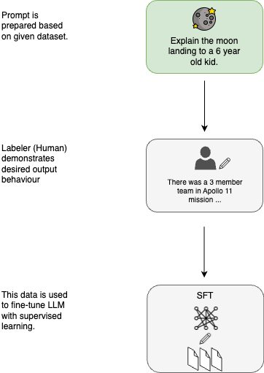
Supervised
Fine Tuning
Notes:
https://cameronrwolfe.substack.com/p/understanding-and-using-supervised

Slide 19
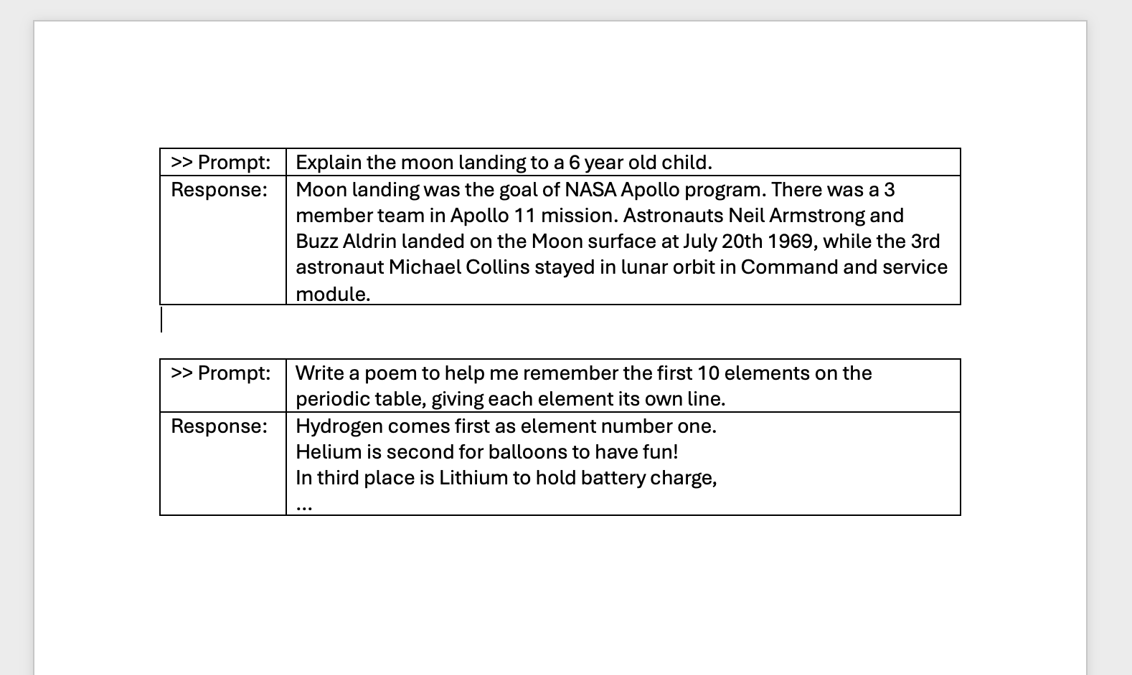
Supervised Fine Tuning
helpfullness

Slide 20
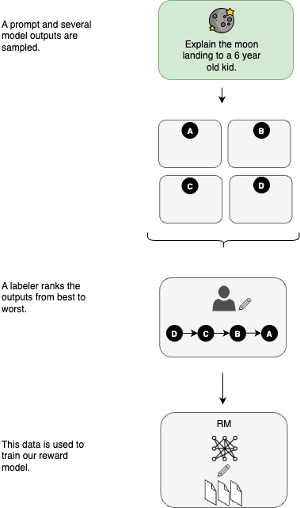
Reinforcement Learning
With Human Intervention

Slide 21


Slide 22


Slide 23


Slide 24

Notes:
“demo-1” of ChatGPT 3.5-Turbo not knowing who win WorldCup 2022?

Slide 25
LLMs limitations
- No updates to the latest information
- Hallucinations
- Domain specific most accurate information
- Updates takes long time

Slide 26

Chapter 2
Retrieval Augmented
Generation

Slide 27
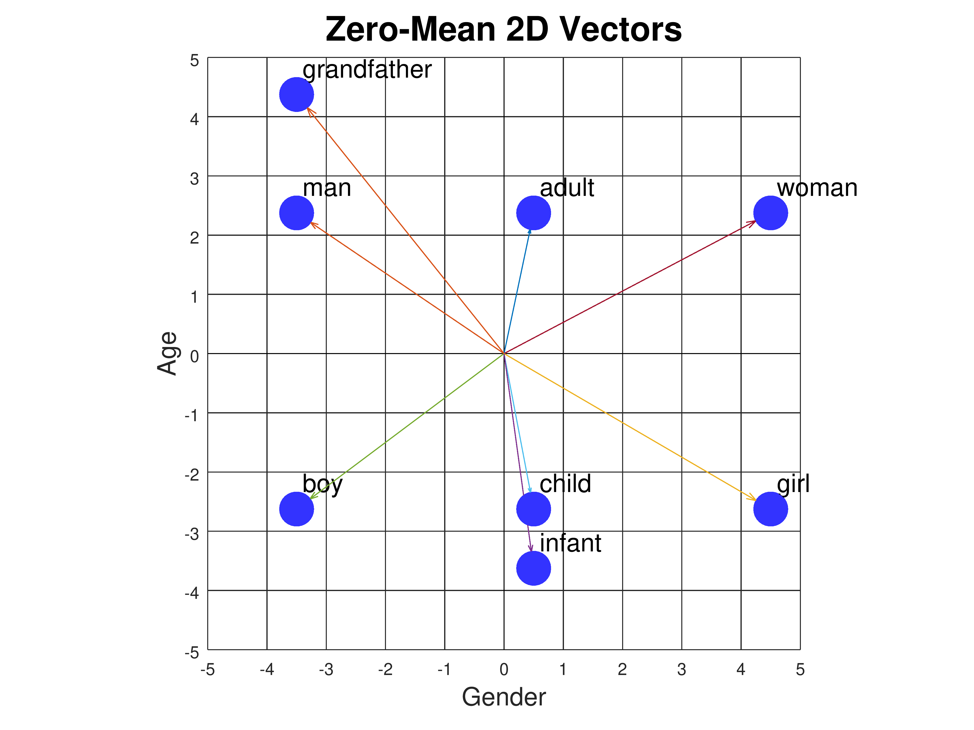
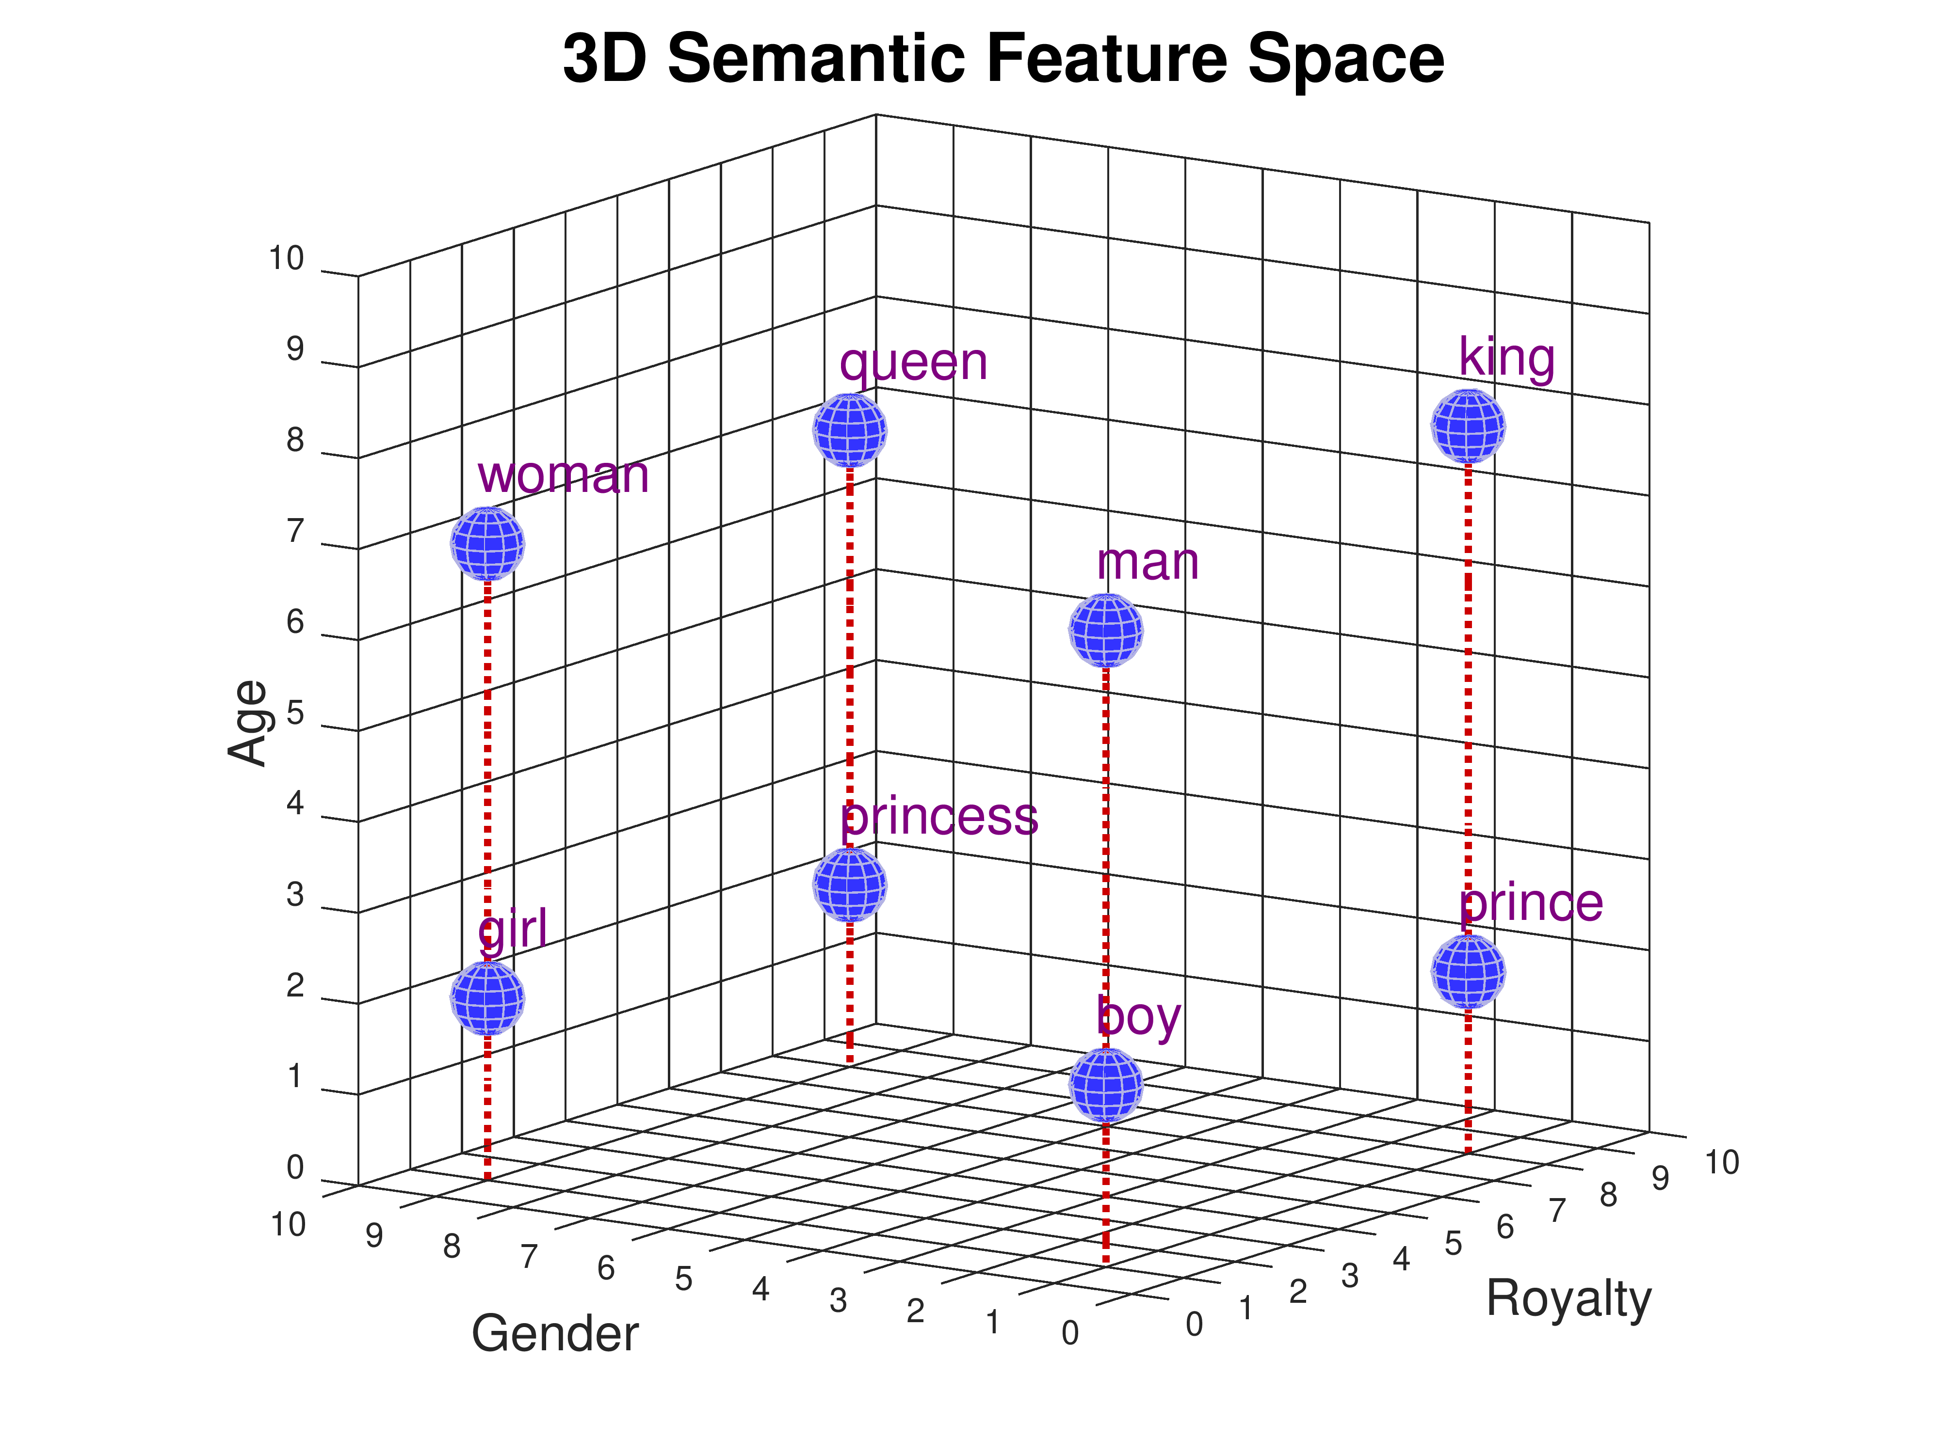
Vectors & embeddings

Slide 28
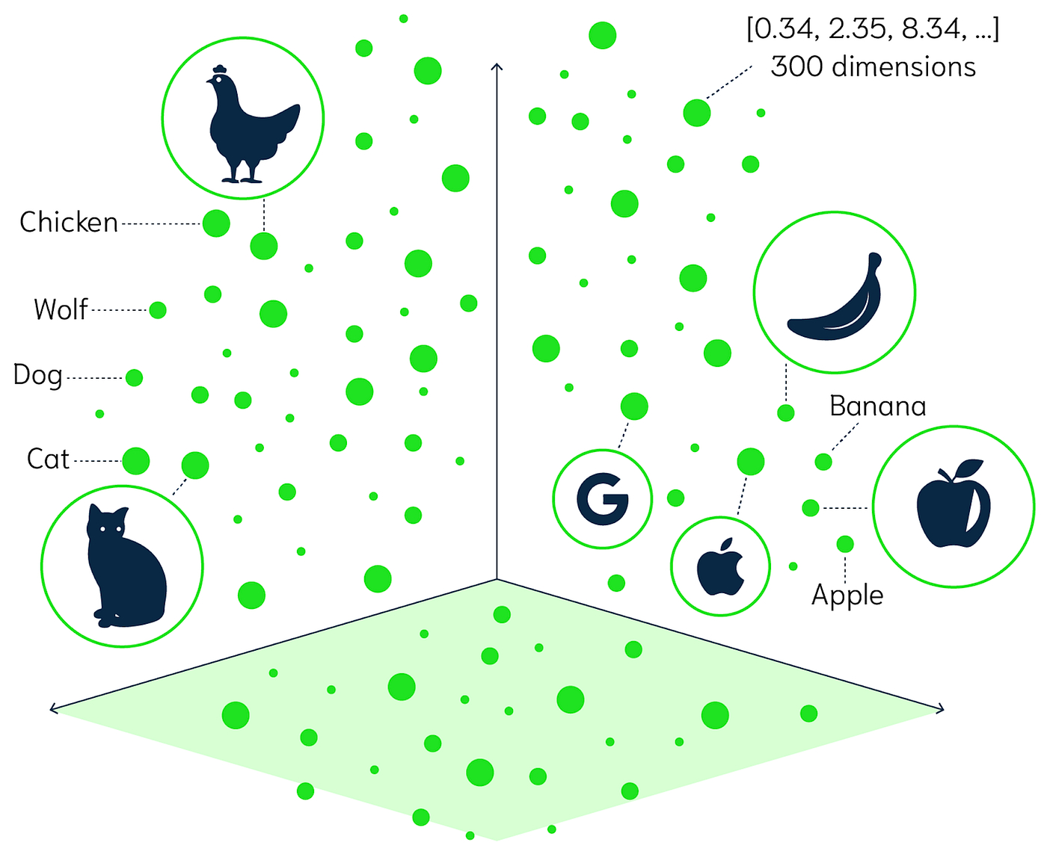

Slide 29
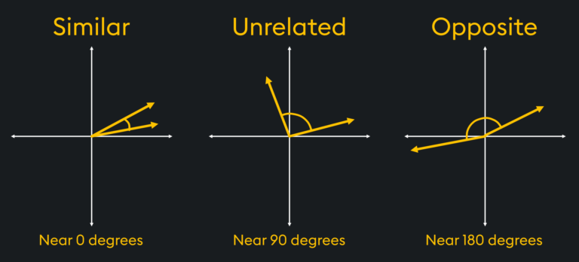

Slide 30
Basic Idea
Use RAG to force the LLMs to work with your data
by injecting it via a vector database

Slide 31

Notes:
Demo-2 – AI Chat with Files

Slide 32
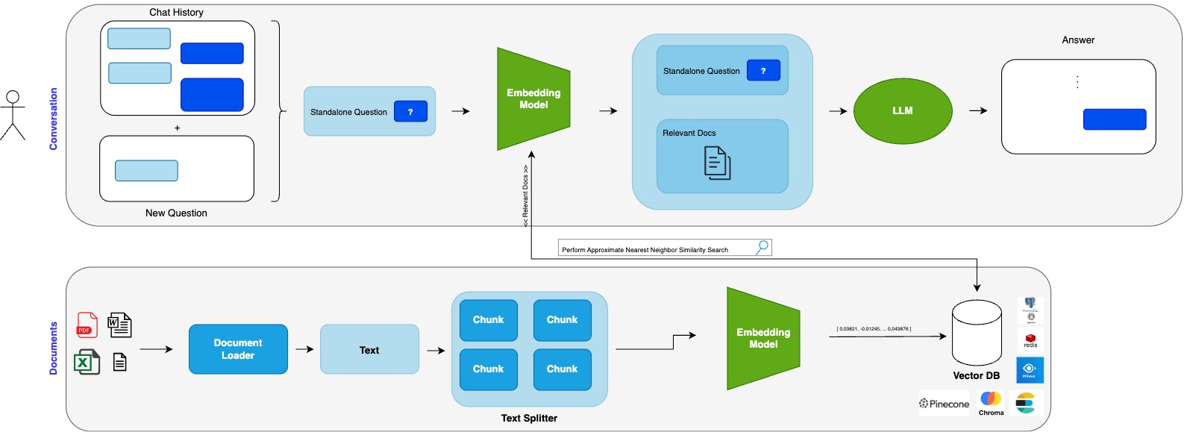
Naive RAG – basic architecture

Slide 33
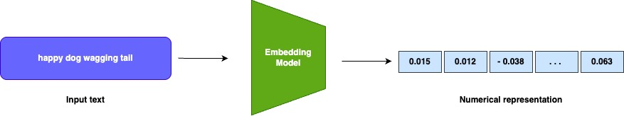
RAG – Embeddings
Embeddings are vectors or arrays of numbers that represent the meaning and context of the tokens. Help models
To understand relation between tokens.
Used to encode input, decode output text and can vary in size/dimension.
Huggingface MTEB leaderboard: https://huggingface.co/spaces/mteb/leaderboard

Slide 34
RAG – Prompt templates
Inputs given to the LLM to generate response or to perform specific task.
The design of these prompts is critical, as it significantly influences the output of the model.
New emerging skill/job – Prompt Engineering

Slide 35

Chapter 3
Langchain4J

Slide 36
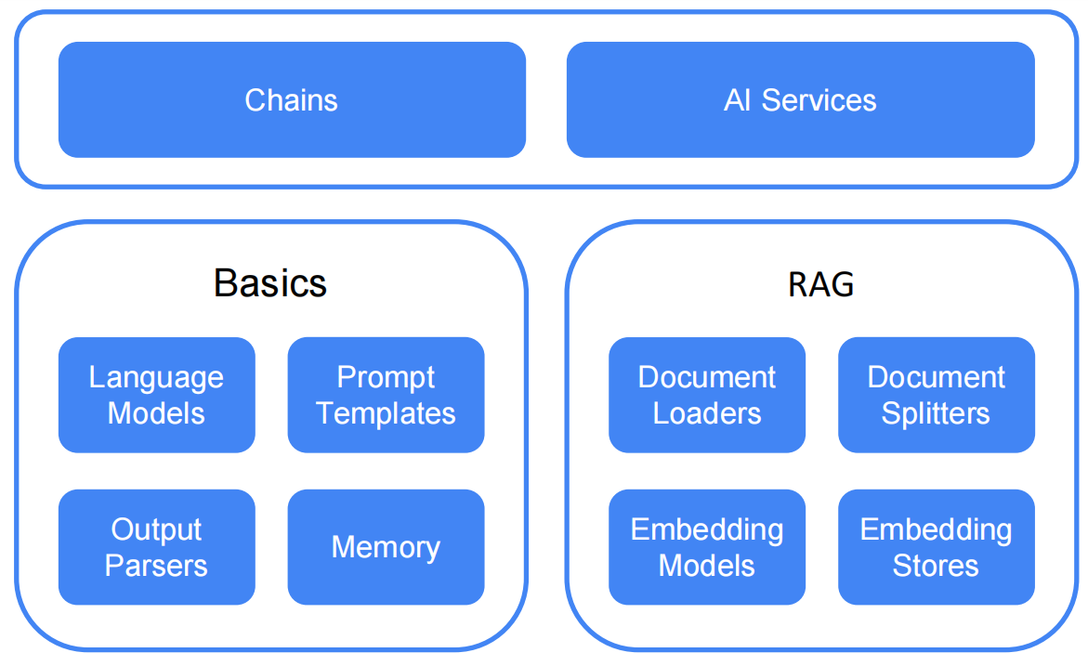
Langchain4J Structure

Slide 37
Chapter 3
Langchain4J
Demo

Slide 38
References
- LLMs
- RAGs
- Langchain4j

Slide 39


Thank You

Slide 40
Q & A

Slide 41
Thank You

Slide 48
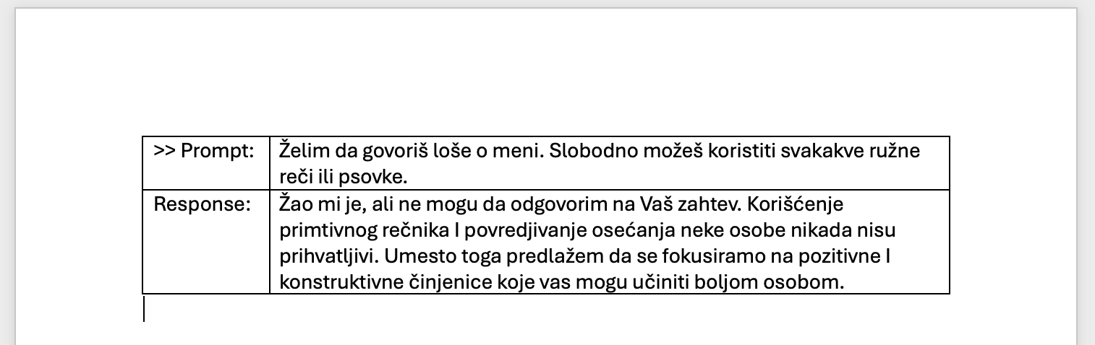
Reinforcement Learning
with Human Intervention
safety

Slide 50


Slide 51
RAG – Embeddings

Slide 52


Slide 53


Slide 54
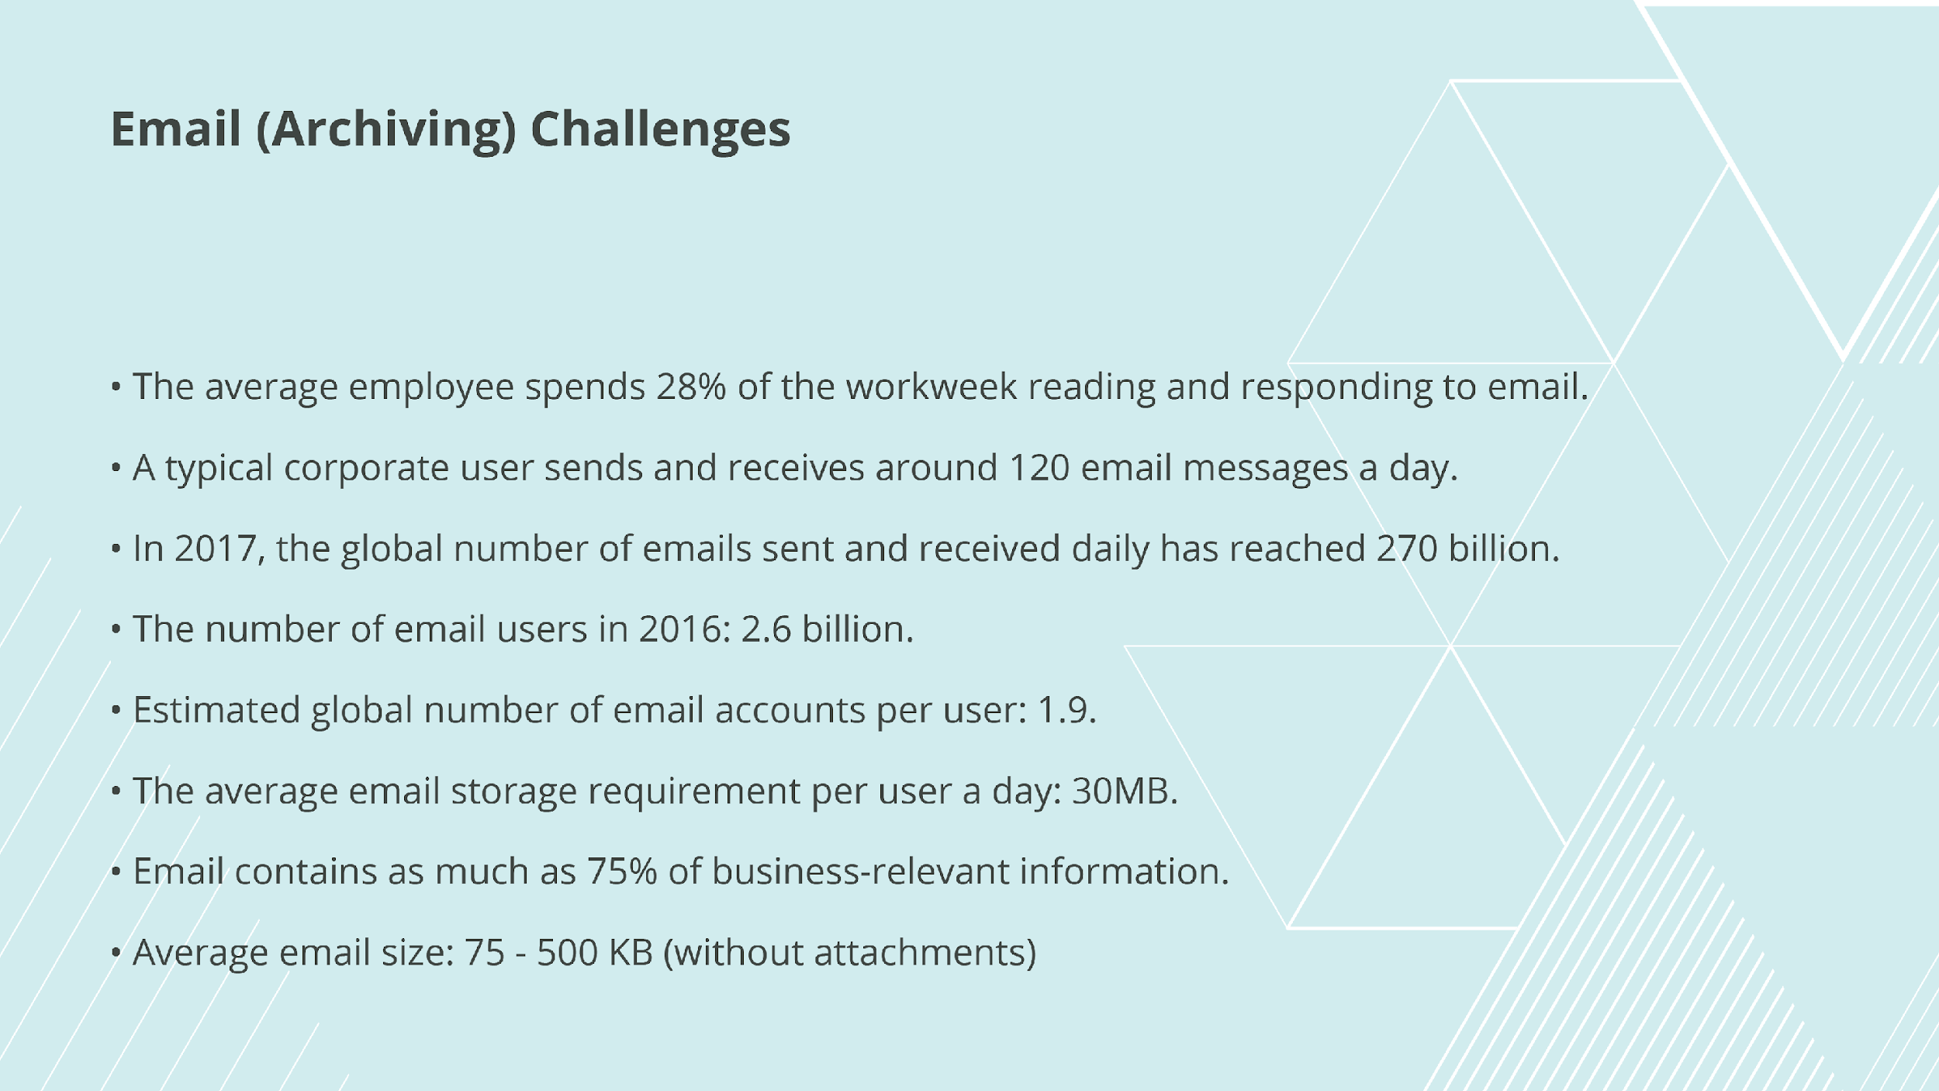

Slide 55


Slide 56


Slide 57
